Slide 1
Expect more, Pay less
ADSTORE FREE TEMPLATE
With BA 허현

Slide 2
INDEX
CONTENTS
DESIGN
TRENDS
PROMOTION

Slide 3
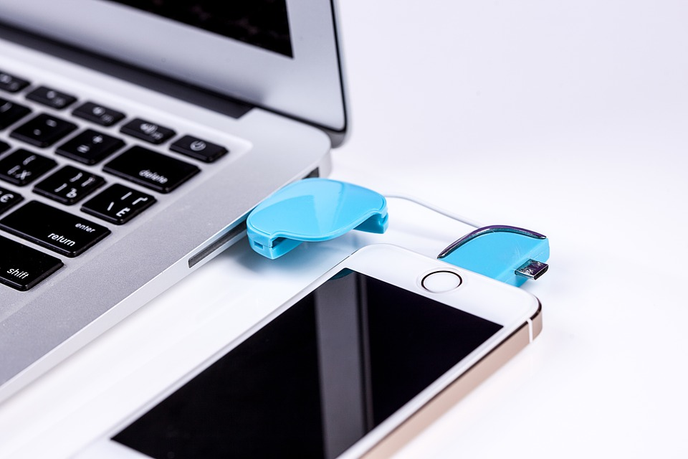
DESIGNED BY ADSTOREPOST.COM
PT DESIGN
PURE
RED+
WHITE
BASIC POWERPOINT PT DESIGN
CONTENTS
Start by doing what's necessary; then do what's possible; and suddenly you are doing the impossible.
- Francis of Assisi

Slide 4
DESIGNED BY ADSTOREPOST.COM
우리의
안전지대
OUR
SAFETY
ZONE
BASIC POWERPOINT PT DESIGN
CONTENTS
The best preparation
for tomorrow is
doing your best today.
- H. Jackson Brown, Jr.
TEAM
ADSTOREPOST
4

Slide 5
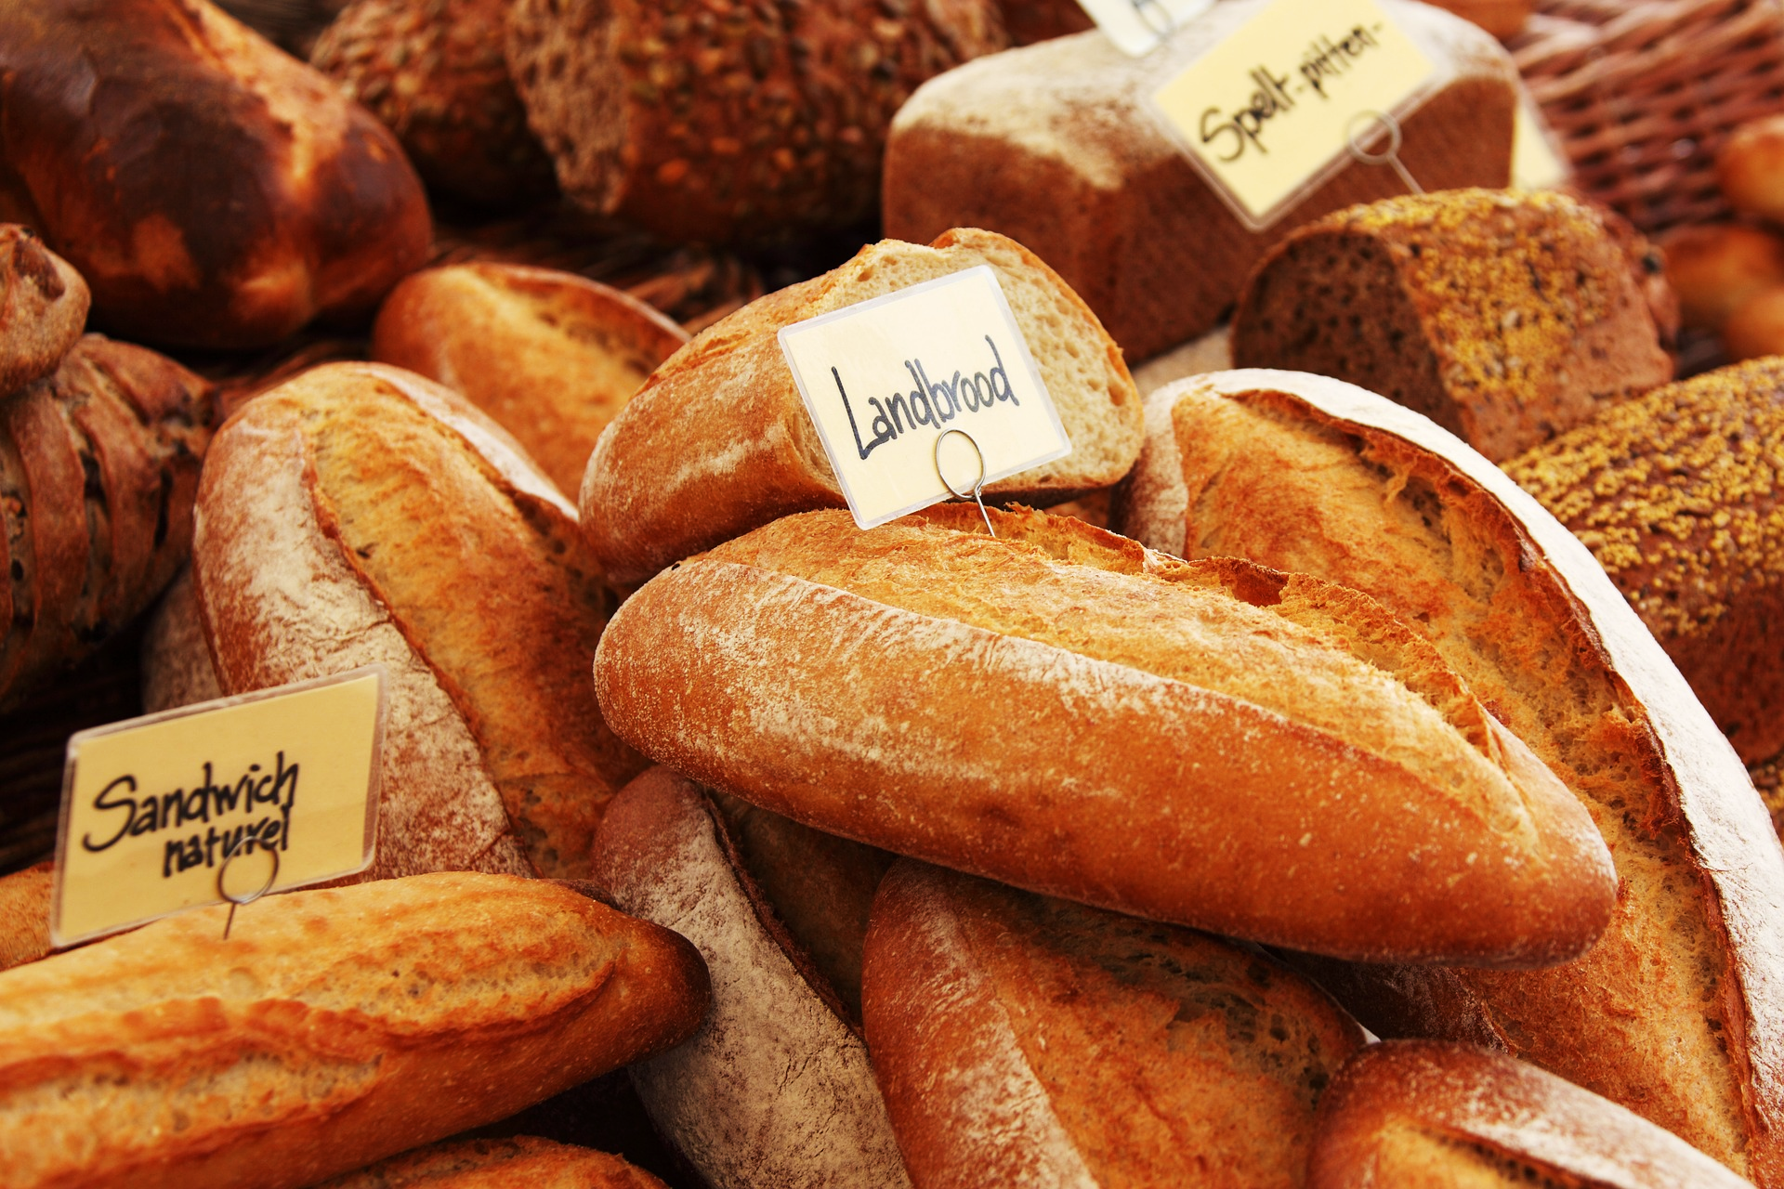
DESIGNED BY ADSTOREPOST.COM
우리의
안전지대
OUR
SAFETY
ZONE
BASIC POWERPOINT PT DESIGN
CONTENTS
The best preparation
for tomorrow is
doing your best today.
- H. Jackson Brown, Jr.
ADSTOREPOST

Slide 6
CON TEN TS.
DSEIGNED
B.Y
ADSTORE

